Slide 1
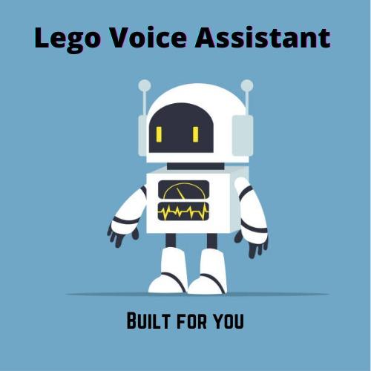
LEGO VOICE ASSISTANT
TEAM LEGOS
PROBLEM STATEMENT:
CONVERSATIONAL APP INTEGRATION WITH THE CORE PRODUCT USING TECHNOLOGY

Slide 2
Flow Diagram
Voice Recognition
LEGO-BOT
PAGE
OUTPUT TO USER
Extraction using NLP
LOGIN PAGE
DATABASE
LOGOUT

Slide 3
Members contributions:
SMRITI: => Extracting required data from the query given by the user by tokenizing. => Used NLP to match required data from database.
SAKSHI:
=> Extracted the query from the audio response. => Passed data extracted from the database to the front end and displayed it.
VINUTHNA: =>Designed Login and Query web pages. =>Implemented the voice input and output in the UI.
NEHA:
=> Validation of login using the database.
=> Integration with the query page using flask.
=> Logout by redirecting back to the login page.
TUSHARA:
=> Coded Voice Recognition part in python and helped for writing its code in HTML.
=> Managed the Database
=> Designed Chat display box.

Slide 4
Additional features to be added
Technology Stack:
Improving the range of inputs accepted.
Multiple languages?
Using the bot for databases in other formats
Mobile login using QR code scanner.
Detailed analysis of Employee performance per annum
Search history storage.
Frontend: HTML, CSS, JavaScript
Backend: Python, Flask
Libraries: Pandas, Spacy, Requests, JQuery, Bootstrap
APIs : HTML5 Speech Recognition API

